Slide 1
Maximum Likelihood Estimation with Right Censoring
Will Seed, Harry Ward, Lingyu Tan, Huakai Zhang
Notes:
In this presentation we will look at maximum likelihood estimation with right censoring. I will start with some introductory concepts and then harry will continue on with some derivations of the MLE’s in cases where alpha is known, nick will then consider the case when alpha is unknown and finally kevin will finish us off looking at different types of parametric distributions.

Slide 2
Survival analysis
Survival analysis is the expected duration of time until an event occurs.
Often used in medical studies
Tells us how many people pass a time t without an event occurring
Tells us at what rate an event will happen
The event could be many different things:
Relapse
Death
Failure of a machine part
Pregnancy
Notes:
Survival analysis is slightly different from other branches of statistics we have looked at in the past, as it uses time to event data. It is often used in important medical studies but does have many uses outside of that. In survival analysis we are studying the time that passes until an event occurs and at what rate it happens within a group. That event could be relapse, death, failure of a machine part or maybe something more positive like pregnancy though that may not be the case for some I suppose.

Slide 3

Censoring
Right Censoring: The survival time t is only known to be greater than a certain value.
Reasons:
An individual may leave a study
Study ends before the event has happened
Study Starts
Study ends
Event occurs
Patient A
t
Patient leaves study
Patient B
t
Notes:
Censoring is when we have incomplete data for an individual, in the case of right censoring we know that the time t is larger than the time we have recorded. This can happen for a couple of reasons, some studies end after a certain time so the event may not have occurred for some people but is known to be greater than the time of the study as may be the case for patient A, some studies end after a certain amount of people have had the event so many patients will be cut off for that reason, again this may have happened to patient and some people may leave the study randomly, for personal reasons, this may have happened to Patient B. For both patients we know that the event happened after time t.

Slide 4
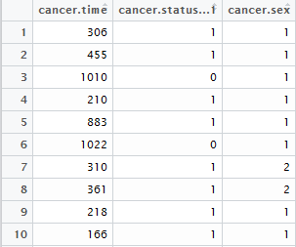
The data
Our data is labelled ‘cancer’ and it is time to event data, we got it from the ‘survival’ R package. The cancer.status column represents censored and uncensored data.
Notes:
We are going to use some data that we have got from the survival package in R, it is time to event data labelled ‘cancer’. This was the name given in the package, it could be time until death for a terminally ill cancer patient or maybe it could be the time until recovery for a patient with a less fatal type of cancer. We chose this data set because it had a lot of results but most importantly it had censored data, this can be found in the cancer.status column, marked with a 0 if it is censored or a 1 if it is uncensored. There is also a cancer.sex column which tells us the sex of the patient however we will ignore this for the minute. You will notice the censored data still has a value in the cancer.time column. This represents the last time we knew that the event had not happened to the patient. So if we look at patient 3, after 1010 days the event had not occurred but beyond that we do not know.

Slide 5
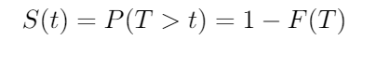
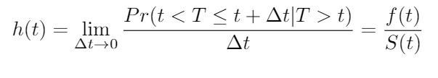
Survival and hazard functions
The survival function gives the probability that a subject will not experience the event until a specified time t. It is given by:
Where F(T) is the CDF so S(t) is monotonically decreasing. This is in the case where no data is censored, when we do have censored data we can use the Kaplan-Meier method
The Hazard function is the probability that the event happens at t given the subject has reached t.
Notes:
The function we will be focussed on mostly is the survival function and this gives the probability a patient will not experience an event until time t. It is given by s(t) = probability = 1 – F(t) but only when no data is censored. When we have censored data we can use the Kaplan-Meier method or parametric estimations. The hazard function or hazard rate is also important in survival analysis, it can be defined as the limit of this probability which can be shown to be equal to f(t)/S(t) where f(t) is the PDF and S(t) is the survival function. This relationship will be important when harry is deriving the maximum likelihood estimate.

Slide 6
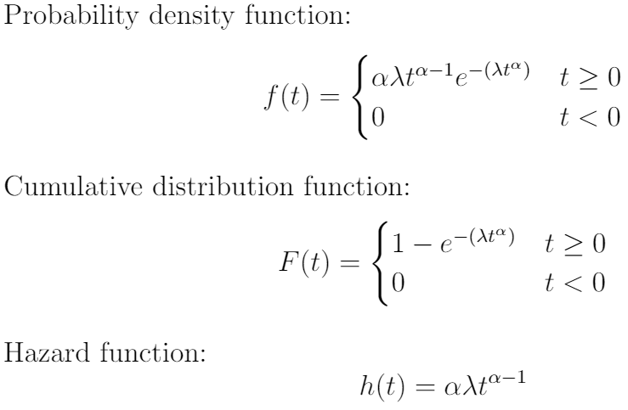
Weibull Distribution
The Weibull Distribution is a popular distribution used in survival analysis, reliability engineering and failure analysis. The distribution is a continuous probability distribution for random variables which take values between zero and infinity.
The parameter α (α > 0) is called the shape parameter.
The parameter λ (λ > 0) is called the scale parameter.
Notes:
The Weibull distribution is often used in survival analysis, the reason for this will be shown by kevin later on, it is a continuous probability distribution for random variables which take values between zero and infinity. We have two parameters, alpha the shape parameter and lamda the scale parameter. We have f(t) the probability density function , the CDF and h(t) the hazard function. We will use the Weibull distribution to estimate the survival function S(t)

Slide 7
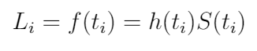
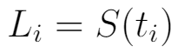
Likelihood formula
From methods introduced in MAS2901 we can find the Likelihood function of the Weibull distribution. However, we first need to alter the function to account for censoring.
If a patient died at t_{i} , it’s contribution to the likelihood function is the density at that duration, this can be written as the product of the survival and hazard functions.
If the patient is still alive at t_{i} , all we know under censoring is that the lifetime exceeds t_{i} . Therefore the probability of this event is…

Slide 8
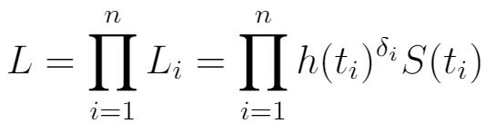
Likelihood formula
This becomes the contribution of a censored observation to the likelihood. Both types of contribution share the survival function, because in both cases the patient lived up to time t_{i} .
A death multiplies this contribution by the hazard function, but a censored observation doesn’t.
We can write the two contributions in a single expression. For this to happen, let δ_{i} be a death indicator, taking the value one if the patient i died and the value zero otherwise. Then the likelihood function can be written as

Slide 9
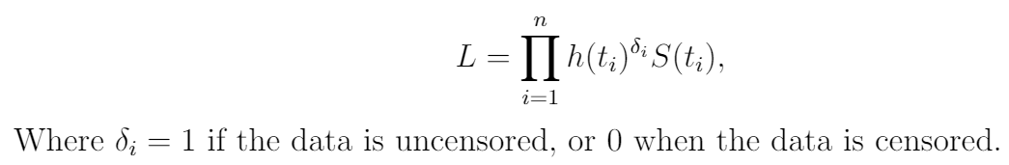
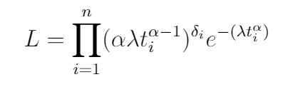
Maximum Likelihood Estimator for Weibull Distribution when alpha is known.

Slide 10
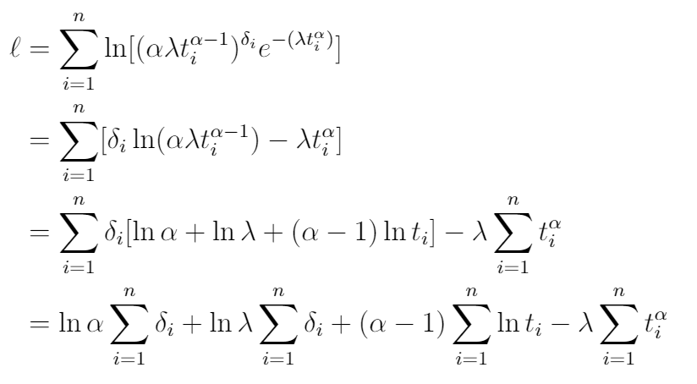
Maximum Likelihood Estimator for Weibull Distribution when alpha is known.

Slide 11
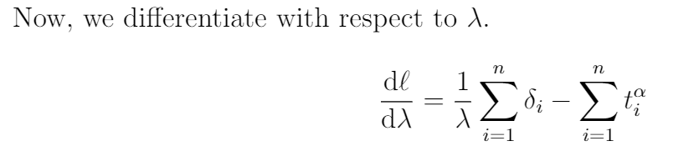
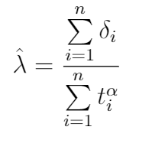
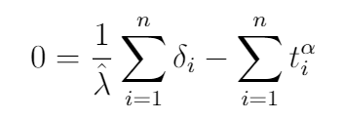
Maximum Likelihood Estimator for Weibull Distribution when alpha is known.

Slide 12
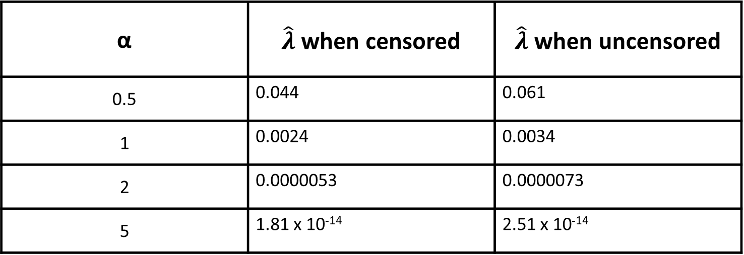
MLE for Cancer data
When using the cancer data, we can estimate what $\hat{λ}$is based on what value of α is known. Using our equation for $\hat{λ}$ we estimate it for values of α as follows:
α | $\hat{λ}$ when censored | $\hat{λ}$ when uncensored
0.5 | 0.044 | 0.061
1 | 0.0024 | 0.0034
2 | 0.0000053 | 0.0000073
5 | 1.81 x 10⁻¹⁴ | 2.51 x 10⁻¹⁴

Slide 13
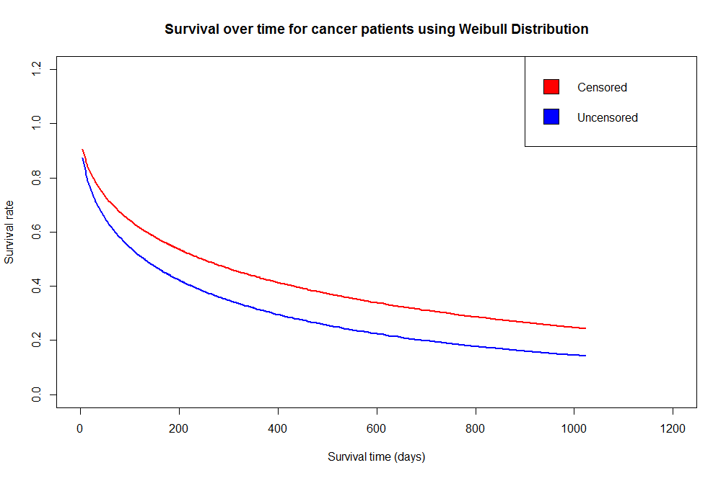
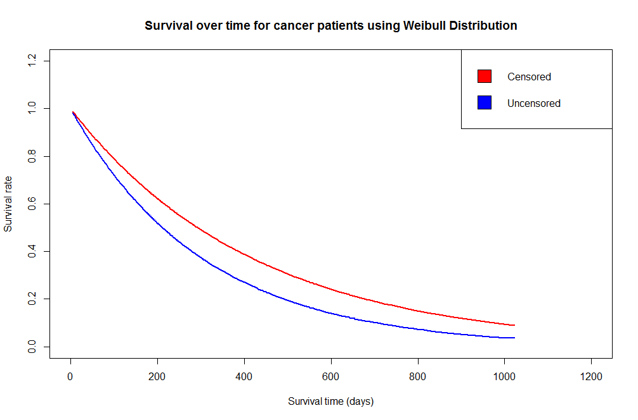
Graphs comparing censored data to uncensored data
α = 0.5 on the graph above
α = 1 on the graph above

Slide 14
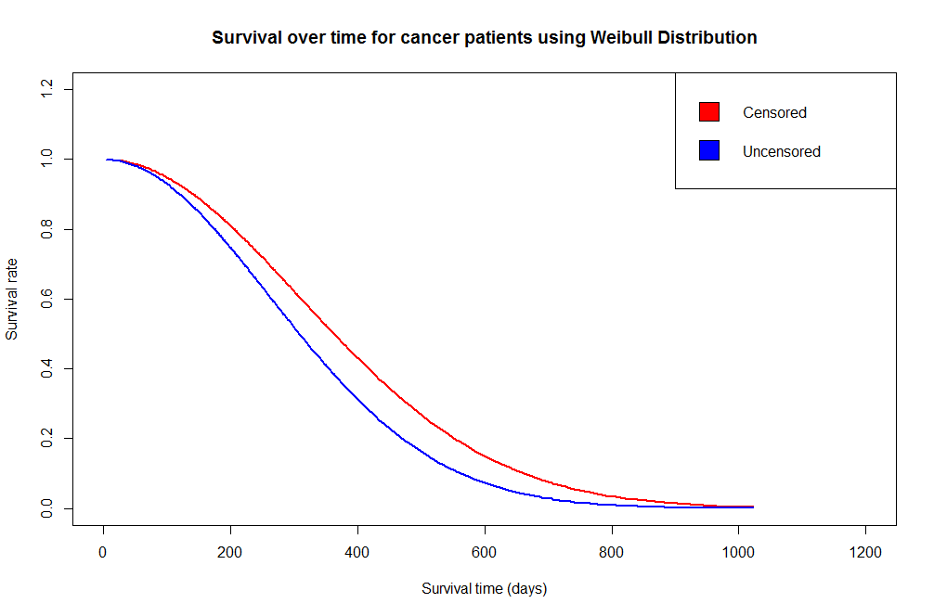
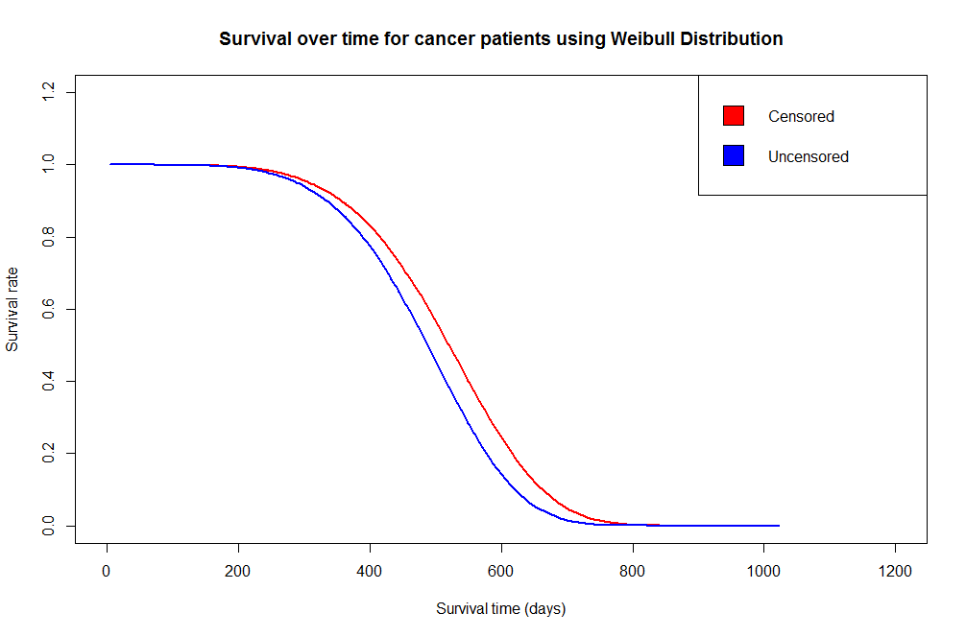
Graphs comparing censored data to uncensored data
α = 2 on the graph above
α = 5 on the graph above

Slide 15
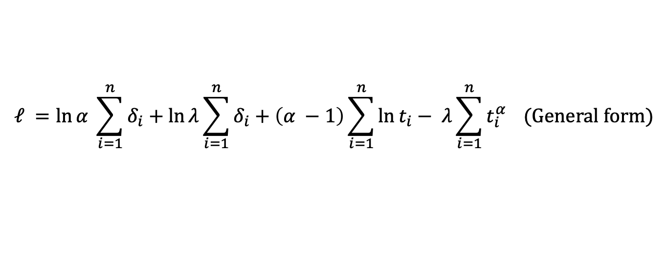


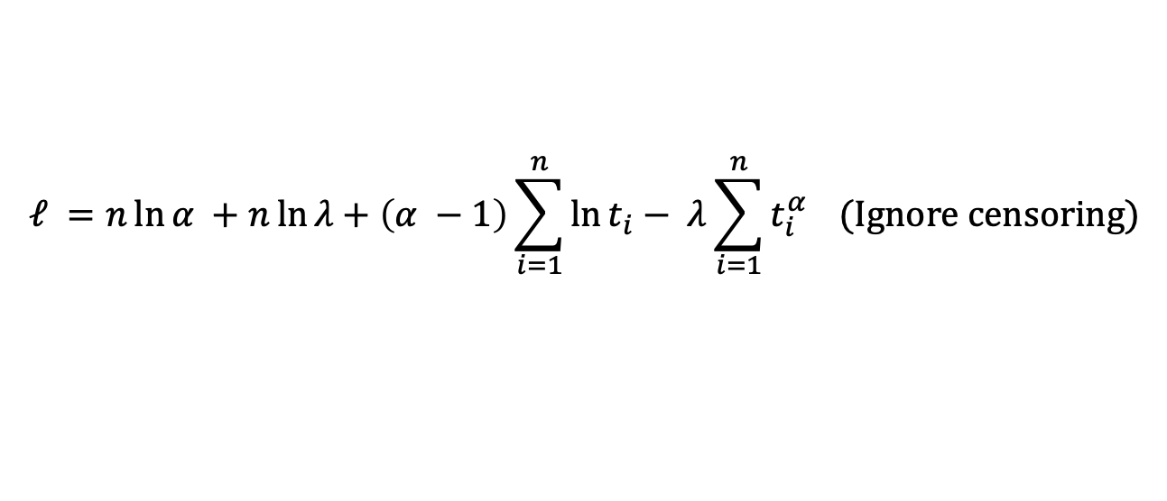
MLE of $α$ and $λ$ for Weibull distribution with $α$ and $λ$ unknown
The log-likelihood function is:
$$ℓ =\ln{α} \sum_{i=1}^{n}{δ_{i}}+\ln{λ}\sum_{i=1}^{n}{δ_{i}}+\left(α −1\right)\sum_{i=1}^{n}{\ln{t_{i}}}− λ\sum_{i=1}^{n}{t_{i}^{α}} (General form)$$
Replace all $δ_{i}$ with 1
$$ℓ =n\ln{α} +n\ln{λ}+\left(α −1\right)\sum_{i=1}^{n}{\ln{t_{i}}}− λ\sum_{i=1}^{n}{t_{i}^{α}} (Ignore censoring)$$
Use function nlm (Non-Linear Minimization){R Stats package} to maximize the log-likelihood function $ℓ$ (minimize $−ℓ$).

Slide 16
MLE of $α$ and $λ$ for Weibull distribution with $α$ and $λ$ unknown
X-axis: Time
Y-axis: Survival rate
+: symbol of censored observations
Does reflect censoring

Slide 17
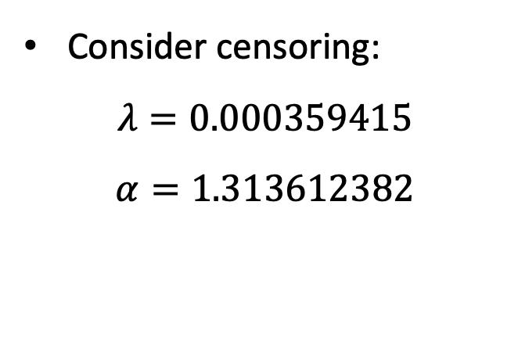
MLE of $α$ and $λ$ for Weibull distribution with $α$ and $λ$ unknown
Consider censoring:
$$λ=0.000359415$$
$$α=1.313612382$$

Slide 18
MLE of $α$ and $λ$ for Weibull distribution with $α$ and $λ$ unknown
Consider censoring:
$$λ=0.000359415$$
$$α=1.313612382$$

Slide 19
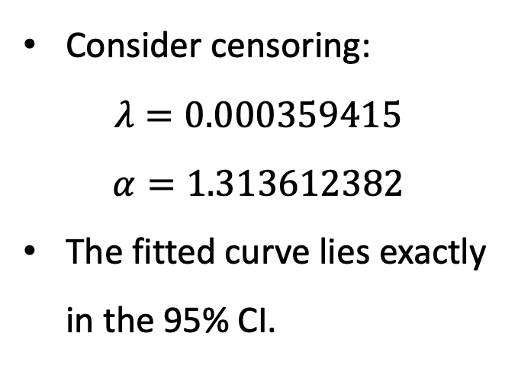
MLE of $α$ and $λ$ for Weibull distribution with $α$ and $λ$ unknown
Consider censoring:
$$λ=0.000359415$$
$$α=1.313612382$$
The fitted curve lies exactly in the 95% CI.

Slide 20
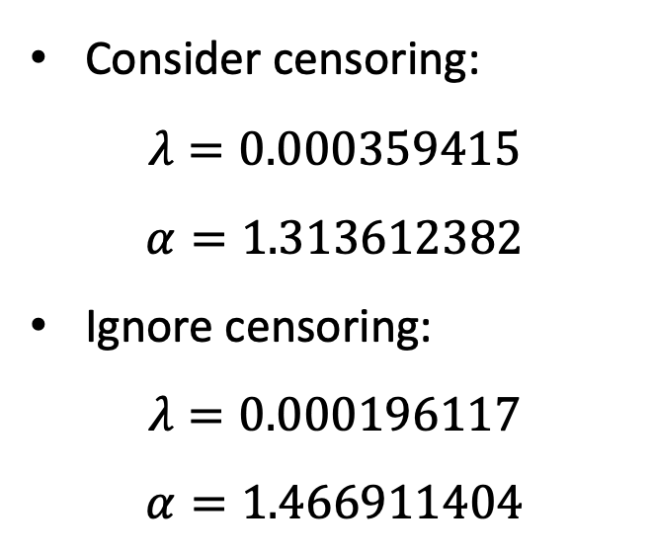
MLE of $α$ and $λ$ for Weibull distribution with $α$ and $λ$ unknown
Consider censoring:
$$λ=0.000359415$$
$$α=1.313612382$$
Ignore censoring:
$$λ=0.000196117$$
$$α=1.466911404$$

Slide 21
MLE of $α$ and $λ$ for Weibull distribution with $α$ and $λ$ unknown
Consider censoring:
The censored curve fits the Kaplan-Meier curve.
Ignore censoring:
The uncensored curve fits the empirical distribution function of survival time (Vertical flip).

Slide 22
Comparison between different types of distributions in survival analysis
Lognormal Distribution
Gamma Distribution
Useful R function
survreg(formula, data, weights, subset, na.action, dist="weibull", init=NULL, scale=0, control,parms=NULL, model=FALSE, x=FALSE, y=TRUE, robust=FALSE, score=FALSE, ...)

Slide 23
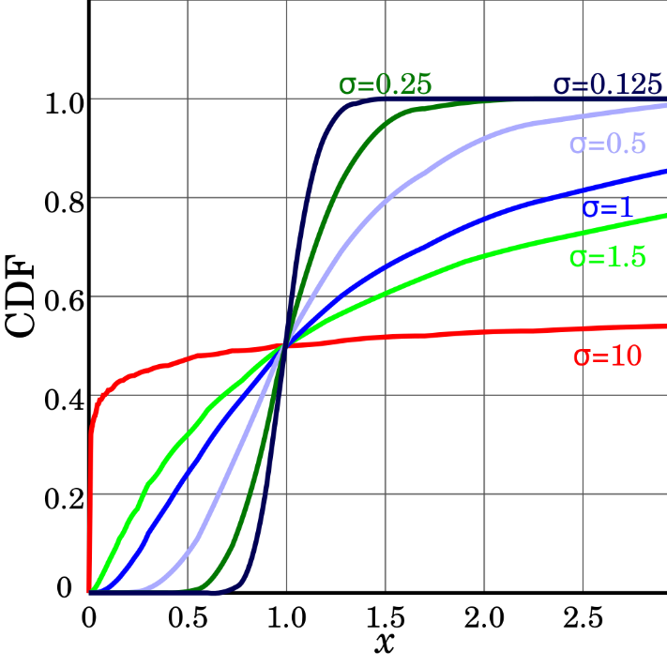
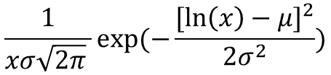
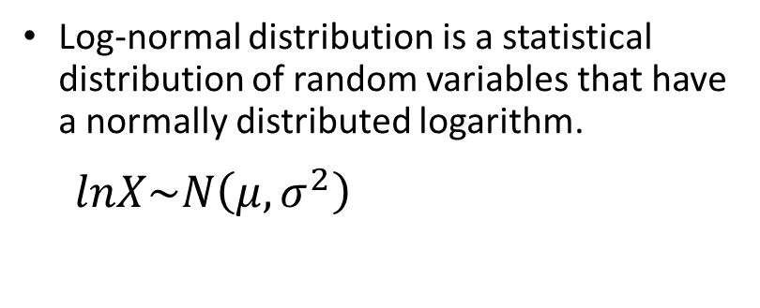
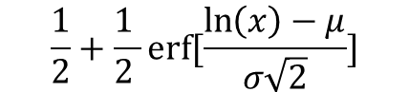
Lognormal distribution
Log-normal distribution is a statistical distribution of random variables that have a normally distributed logarithm.
$$lnX\sim N\left(μ, σ^{2}\right)$$
Probability Density Function:
$$\frac{1}{xσ\sqrt{2π} }exp⁡(−\frac{{[\ln\left(x\right)−μ]}^{2}}{2σ^{2}})$$
Cumulative Distribution Function:
$$\frac{1}{2}+\frac{1 }{2 }erf⁡[\frac{\ln\left(x\right)−μ}{σ\sqrt{2}}]$$
Which erf indicates complementary error function

Slide 24
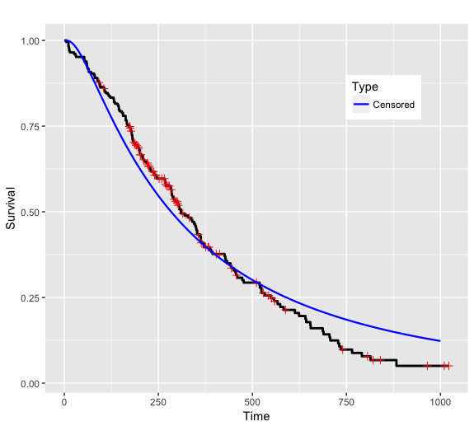
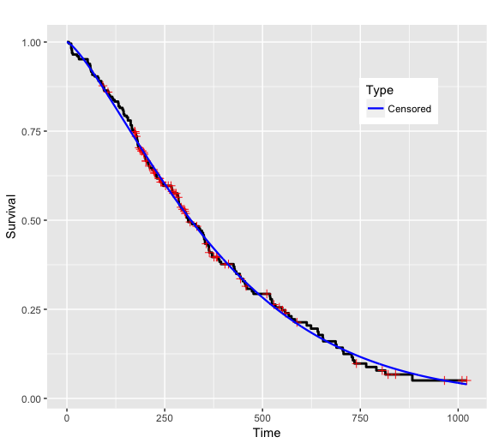
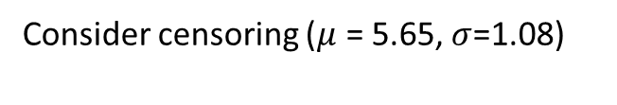
Lognormal distribution result(censoring)
Weibull distribution Result (censoring)
Consider censoring ($μ$ = 5.65, $σ$=1.08)

Slide 25
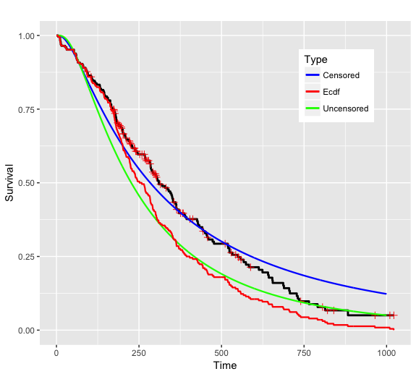
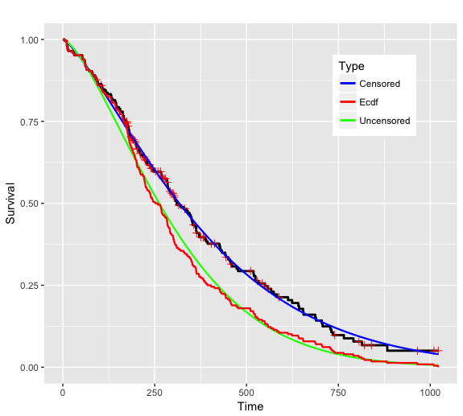

Lognormal distribution result (Ignore censoring)
Weibull distribution result (Ignore censoring)
Consider censoring ($μ$ = 5.65, $σ$=1.08)
Ignore censoring ($μ$= 5.42, $σ$ =0.91)

Slide 26
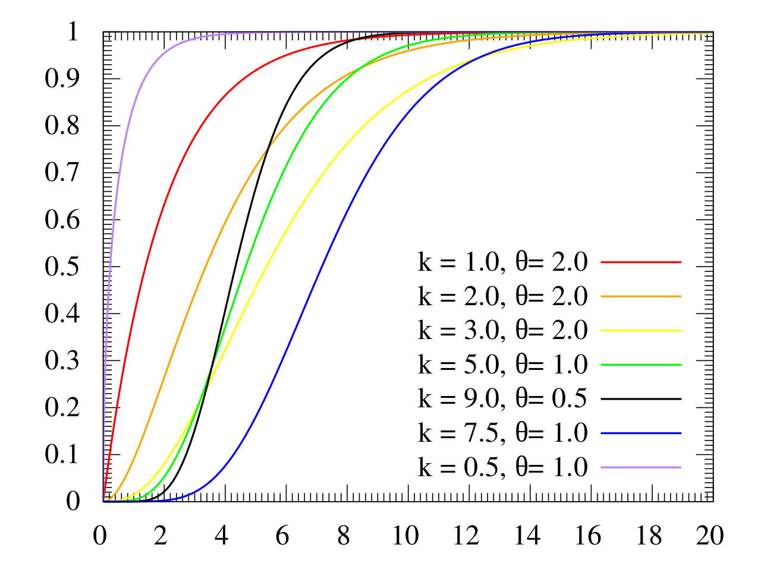
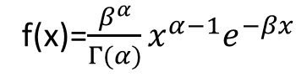
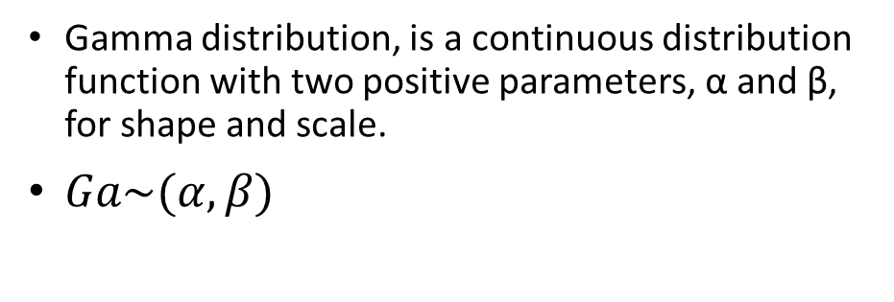
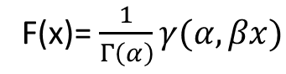
Gamma distribution
Gamma distribution, is a continuous distribution function with two positive parameters, α and β, for shape and scale.
$Ga\sim (α,β)$
Probability Density Function:
f(x)=$\frac{β^{α}}{Γ(α)}x^{α−1}e^{−βx}$
Cumulative Distribution Function:
F(x)= $\frac{1}{Γ\left(α\right)}γ(α,βx)$

Slide 27
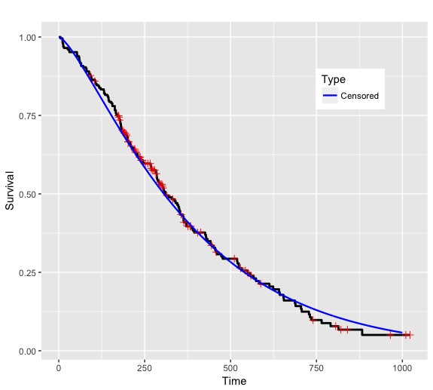
Gamma distribution result(censoring)
Weibull distribution (censoring)
Consider censoring(α = 1.42, β=0.0036)

Slide 28
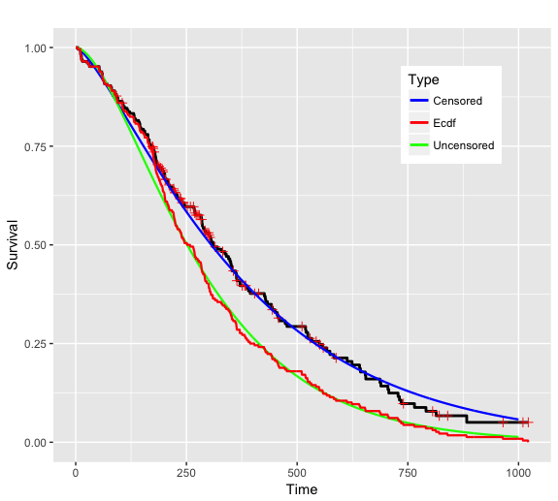
Gamma distribution (Ignore censoring)
Weibull distribution (Ignore censoring)
Consider censoring(α = 1.42, β=0.0036)
Ignore censoring (α= 1.82, β = 0.006)

Slide 29
Conclusion
Overall, we found that Weibull suited very well to survival analysis. Compared to lognormal and gamma, Weibull can be applied more easily to survival data as seen in the cancer data plot we used.

